Slide 1
Activity 2
Harrison Knight

Slide 2
Ground Rules for lamp logic
We will have 8 possible code that will be represented with three bits, ABC, and five outputs, one for each lamp (L1 – L5). A 1 will turn a lamp on and a 0 will turn it off.

Slide 3
Truth Table for lamp logic
A | B | C | L1 | L2 | L3 | L4 | L5
0 | 0 | 0 | 0 | 0 | 0 | 0 | 0
0 | 0 | 1 | 1 | 0 | 0 | 0 | 0
0 | 1 | 0 | 1 | 1 | 0 | 0 | 0
0 | 1 | 1 | 1 | 1 | 1 | 0 | 0
1 | 0 | 0 | 1 | 1 | 1 | 1 | 0
1 | 0 | 1 | 1 | 1 | 1 | 1 | 1
1 | 1 | 0 | x | x | x | x | x
1 | 1 | 1 | x | x | x | x | x

Slide 4
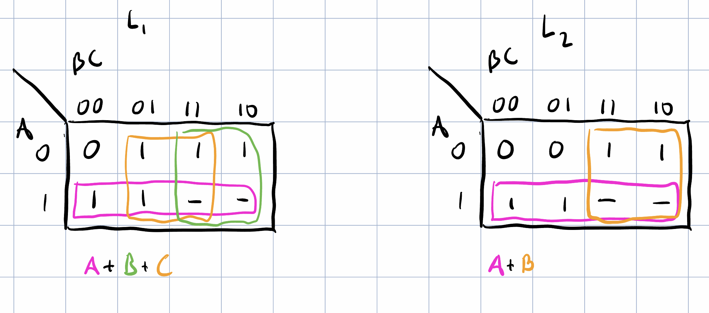
Kmaps

Slide 5
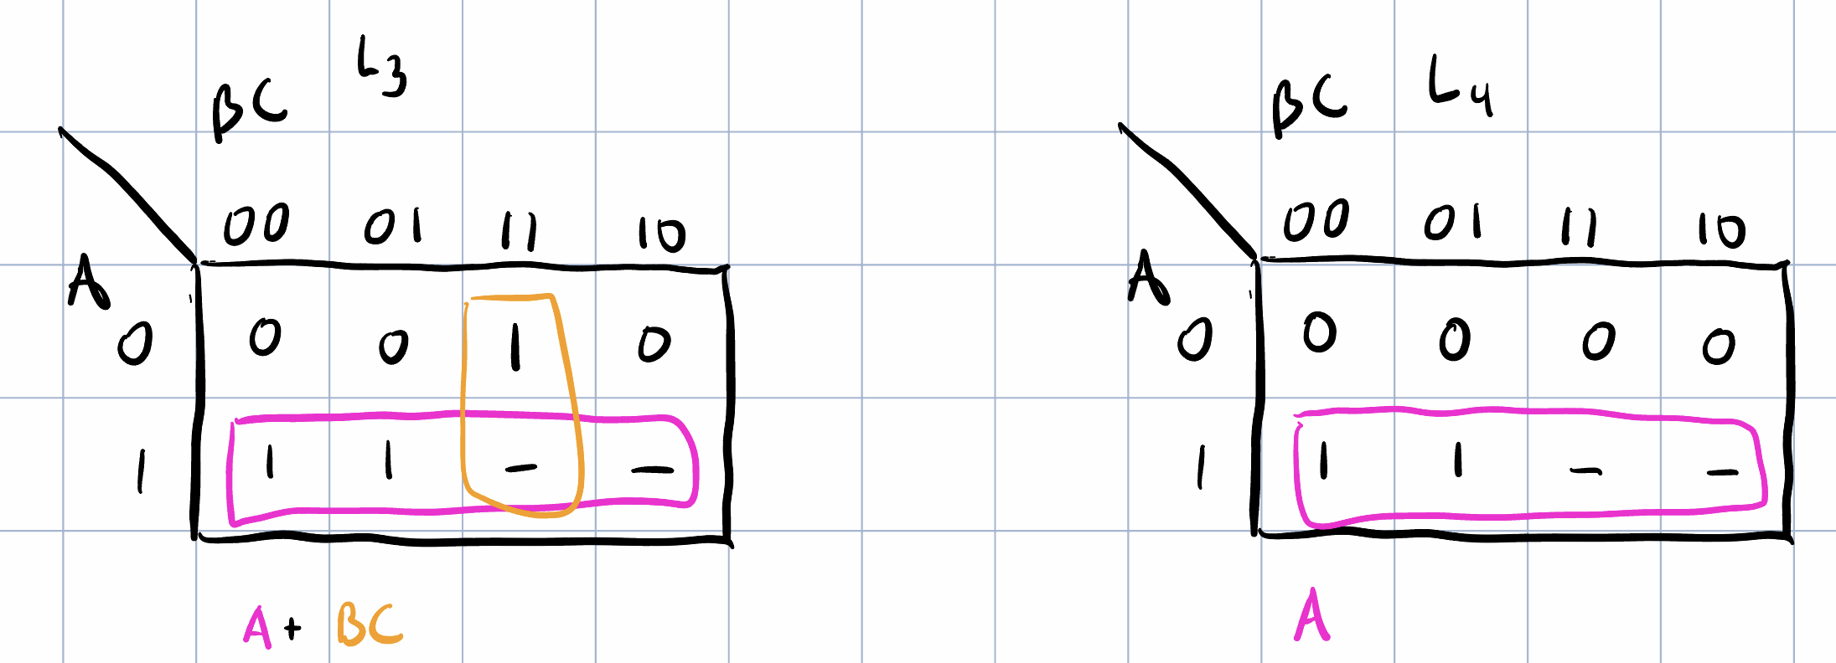
Kmaps (Cont.)

Slide 6
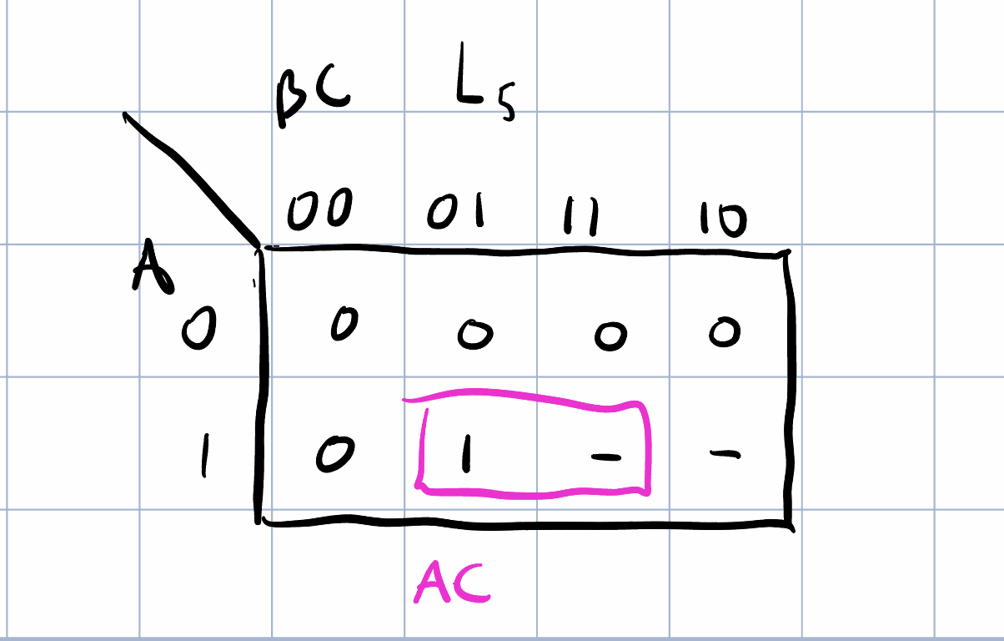
Kmaps (Cont.)

Slide 7
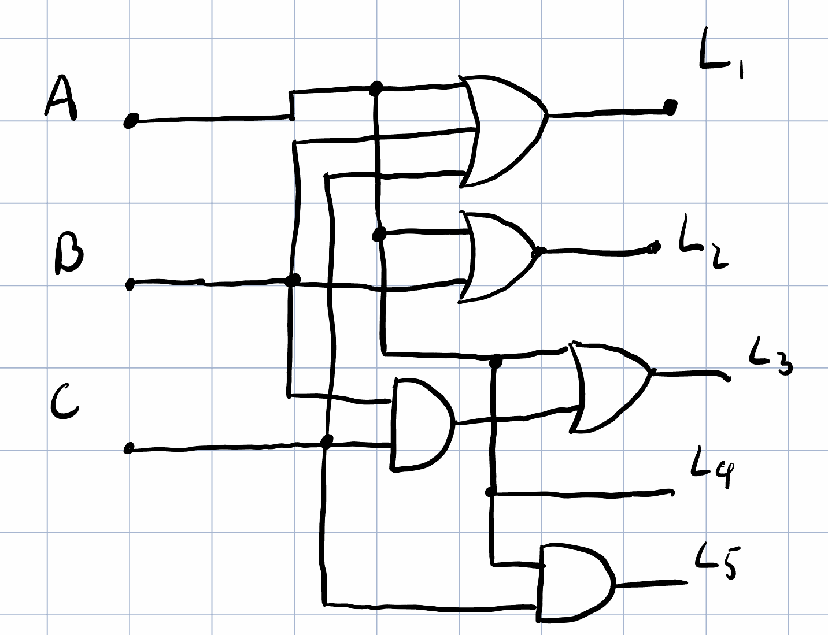
Digital Circuit (3x ICs) (7408, 4075, 7432)

